Slide 1
SQL 1
Hunter Bartlett

Slide 2
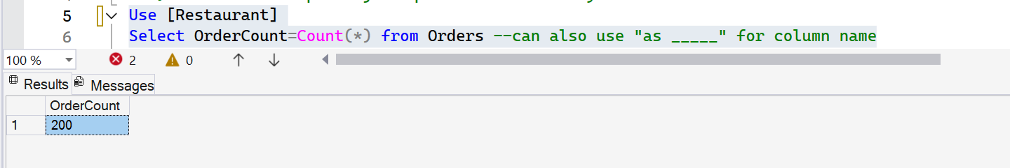
1) Display the count of the number of rows in the Orders table.

Slide 3
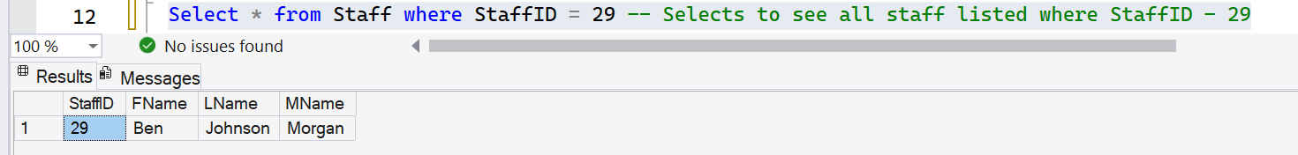
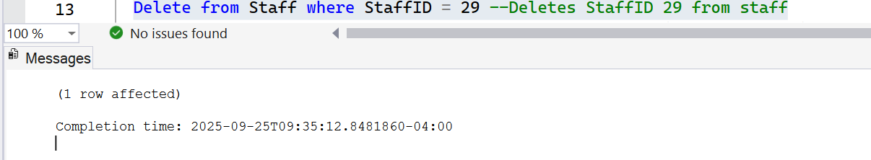
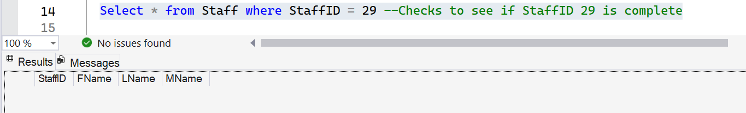
2) Delete a specified record in the Staff table and prove that it is deleted. (before and after)

Slide 4
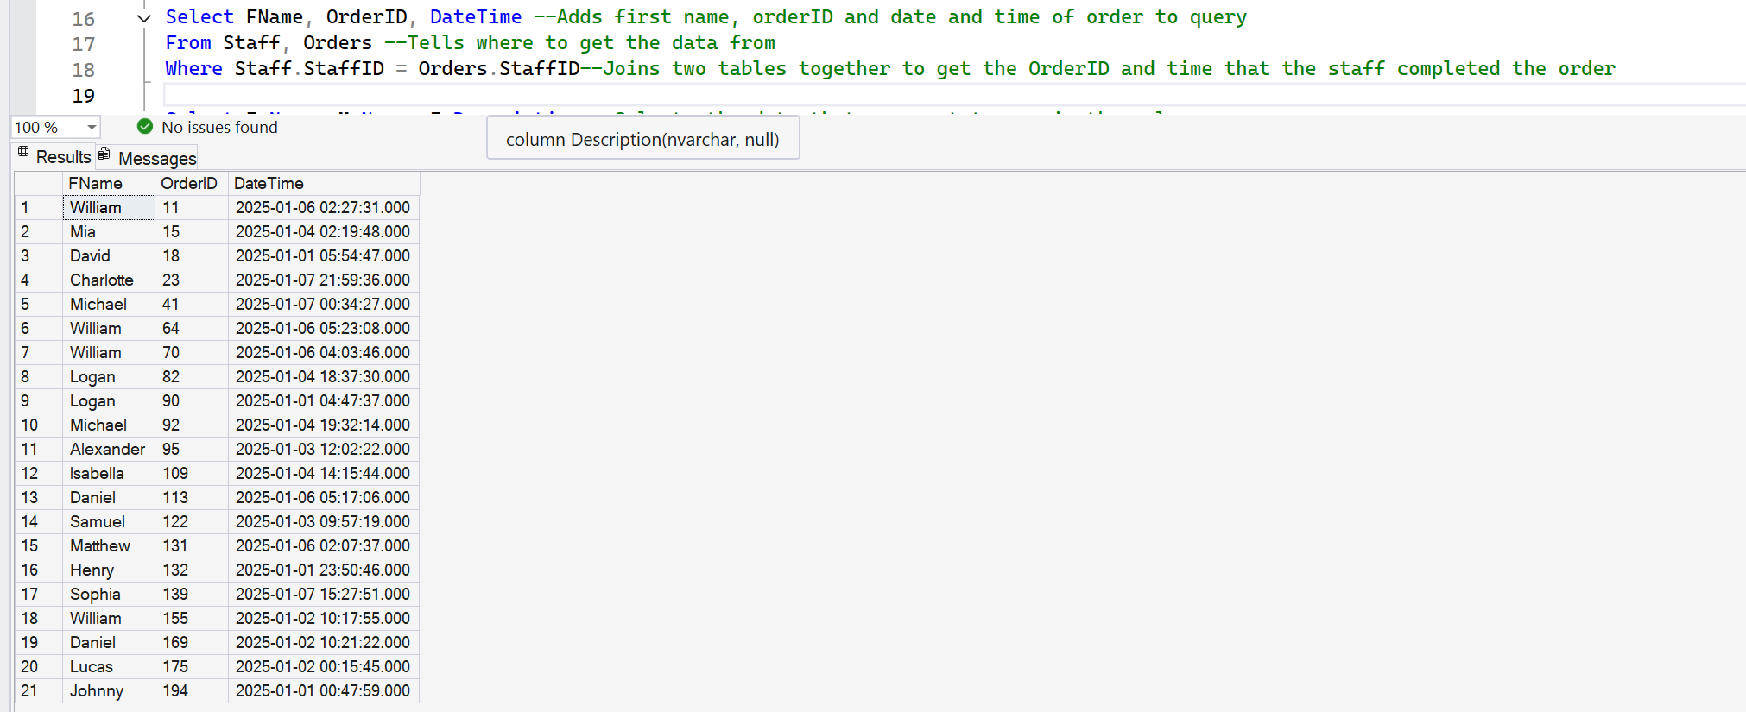
3) Two table implied join qualified with a key value.

Slide 5
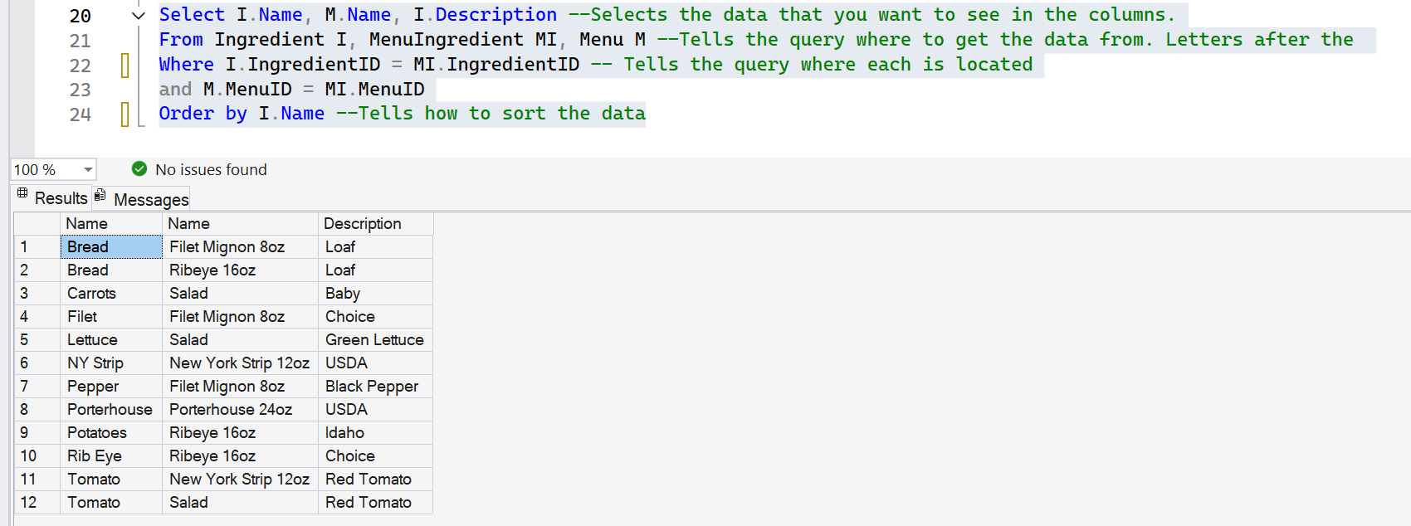
4) Three table implied join qualified with a key value.

Slide 6
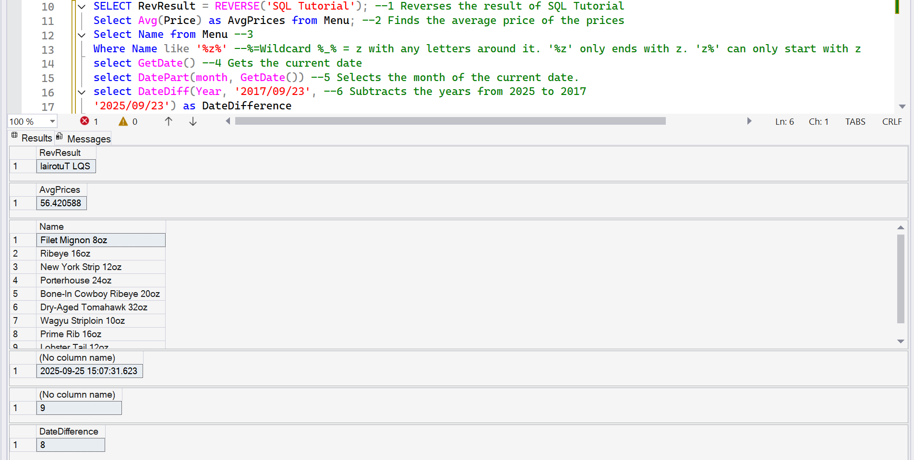
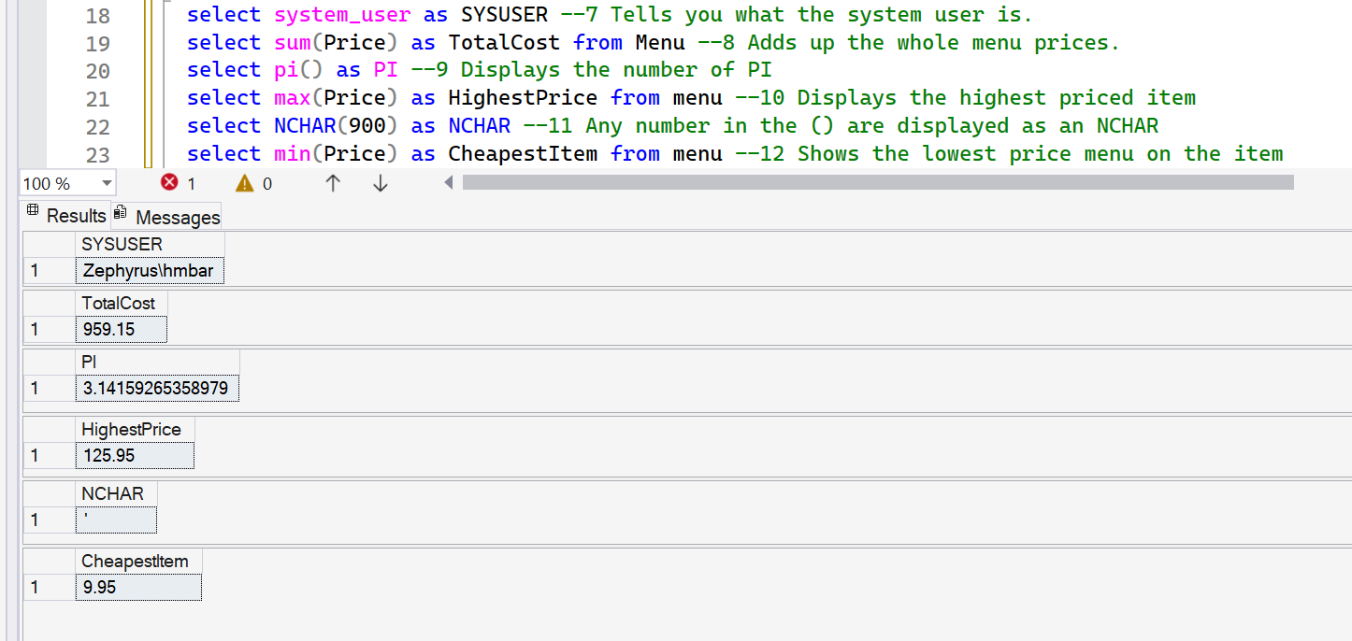
5) Use twelve SQL functions (such as SUM). This should be twelve queries with at least one function for each query

Slide 7
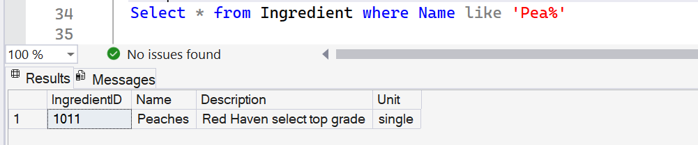
6) Write an SQL statement that utilizes 'like' in the where clause.

Slide 8
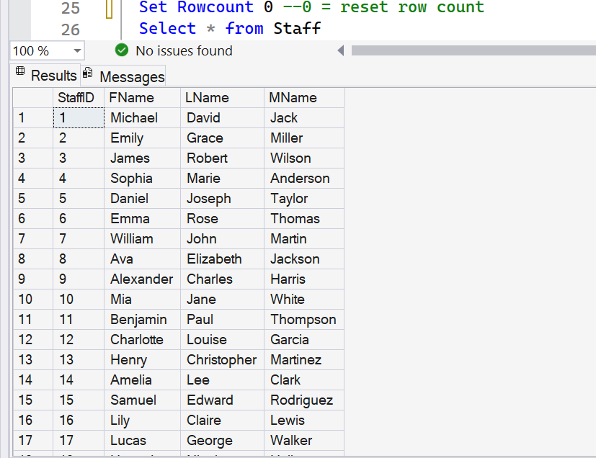
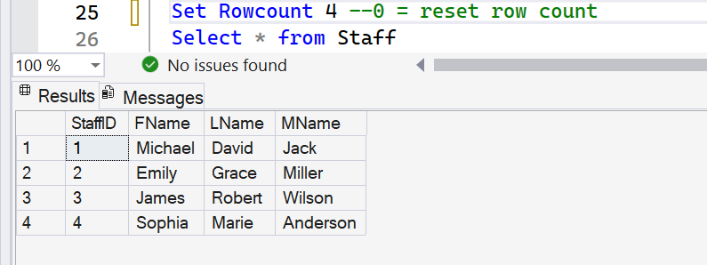
7) Demonstrate the use of the rowcount feature to return 4 rows from a table that has more than 4 rows.
Then demonstrate the use of the rowcount feature to reset the number of rows returned to all of the rows in a table. Demonstrate an alternative to rowcount that has similar functionality.

Slide 9
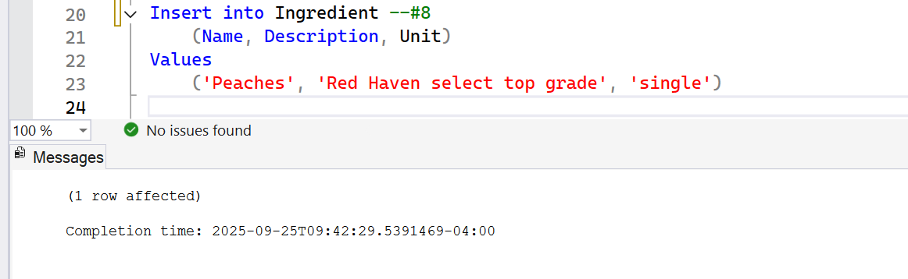
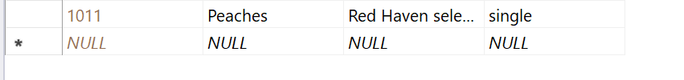
8) Create a SQL routine to insert values into the Ingredient table.

Slide 10
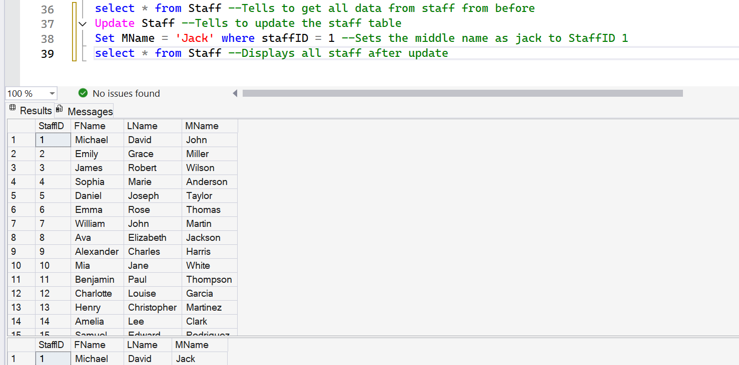
9) Create a SQL routine to update one middle name in the Staff table.

Slide 11
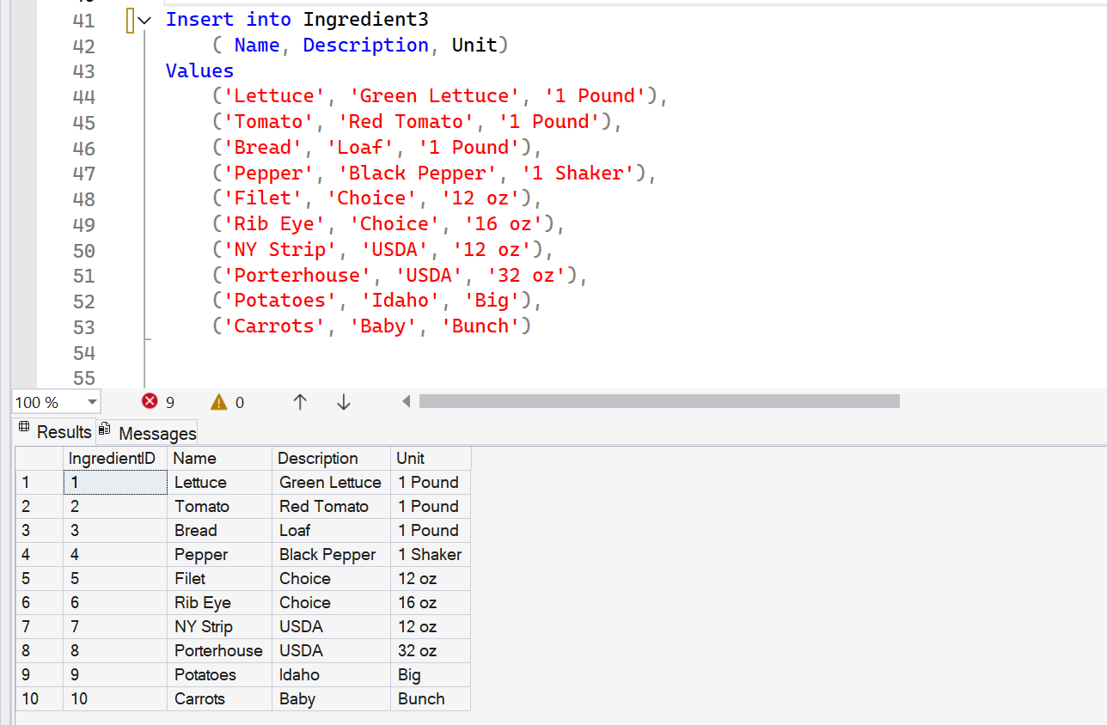
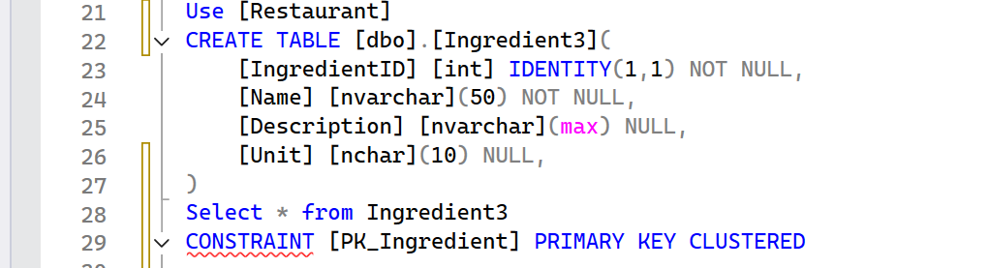
10) Create SQL to truncate and populate a new table with at least 10 rows using data you supply in the insert statement. Table must have at least 3 columns and is not a table in the Restaurant database.

Slide 12
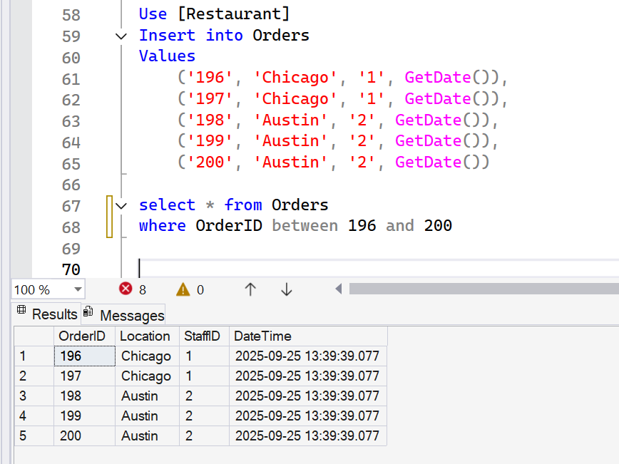
11) Create a SQL statement that inserts 2 Orders for a Staff of your choice and 3 Orders for another Staff of your choice.

Slide 13
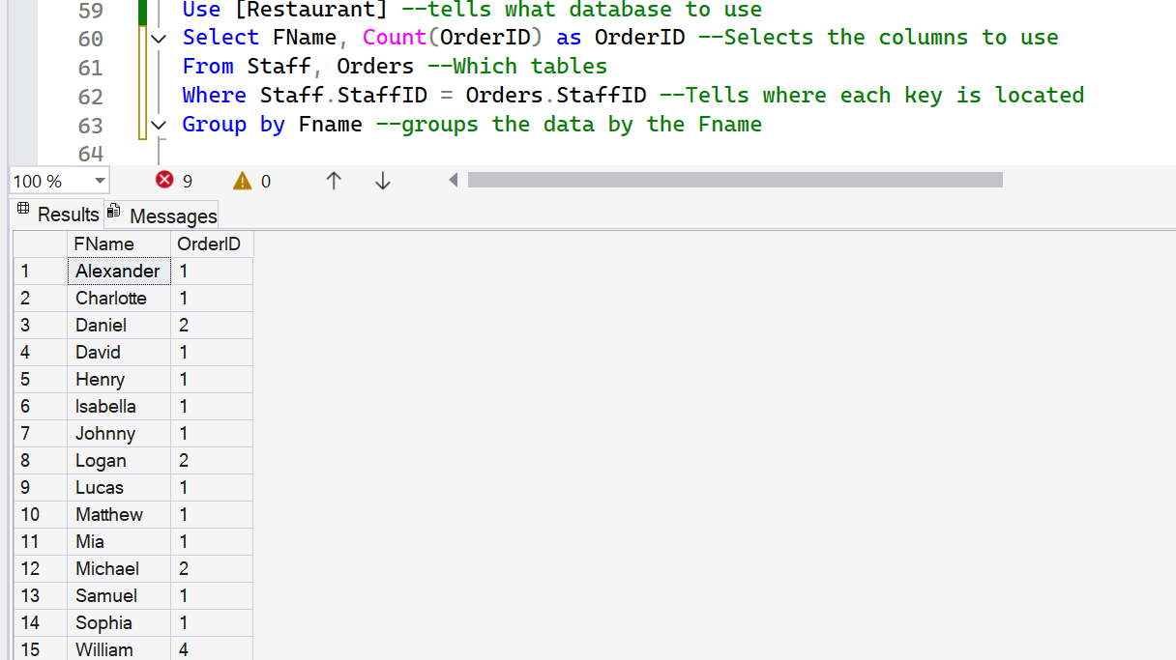
12) Create a query that uses Group By with the Order and Staff table.

Slide 14
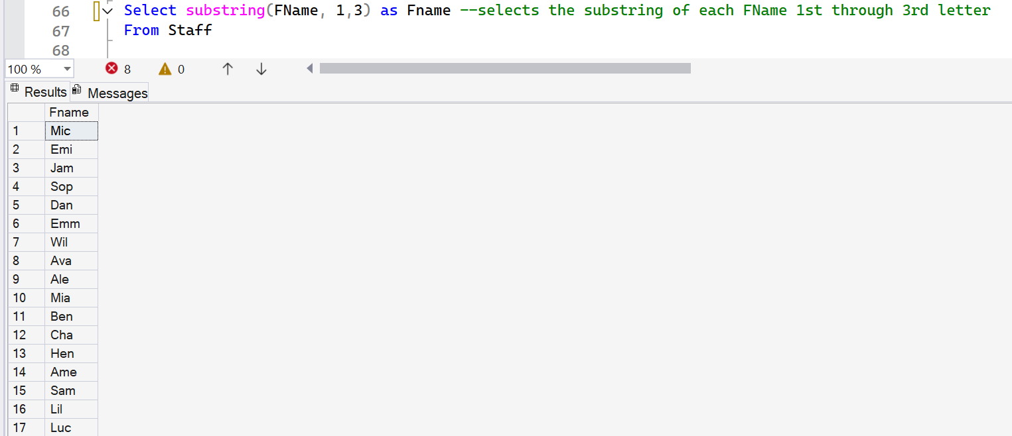
13) Create a SQL statement that utilizes the substring command

Slide 15
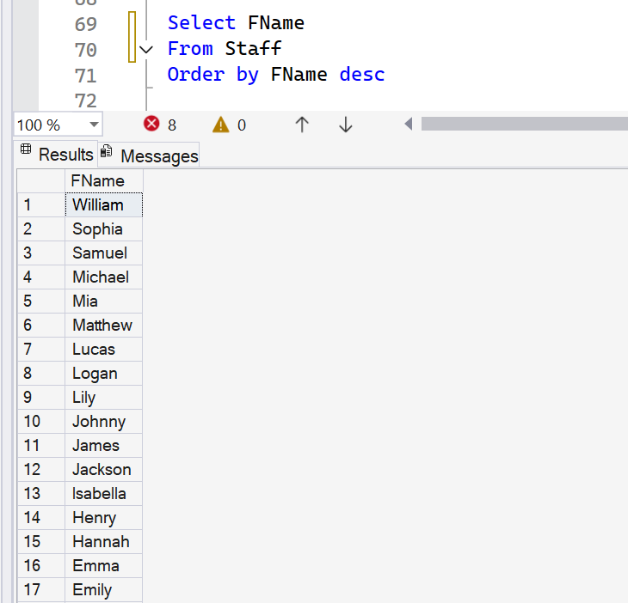
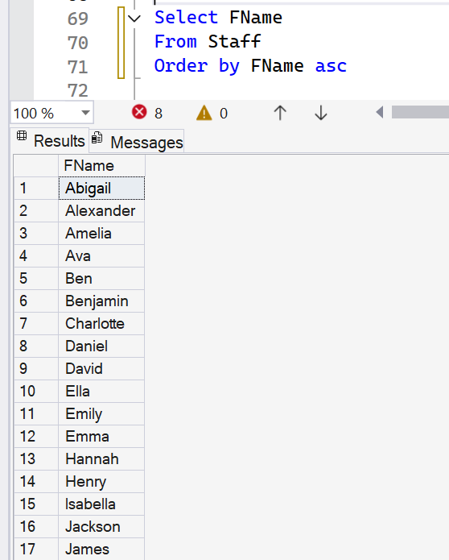
14) Demonstrate the use of distinct, ascending, descending in a query.

Slide 16
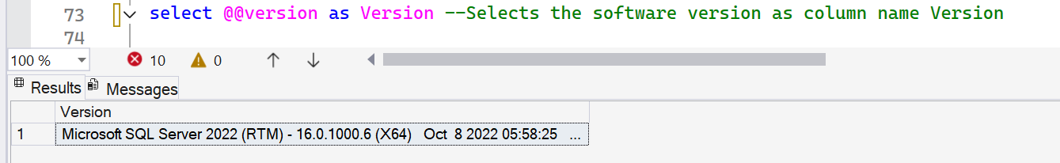
15) Demonstrate @@version

Slide 17
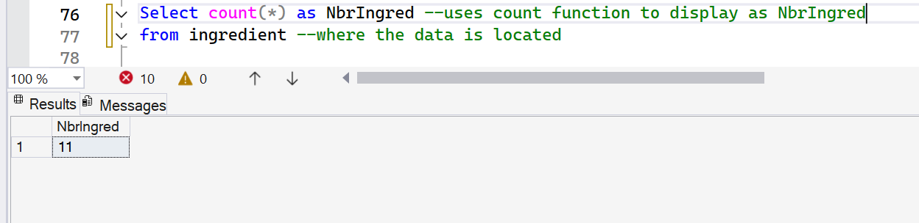
16) How many Ingredients are in Ingredient table (number, not the list of records).

Slide 18
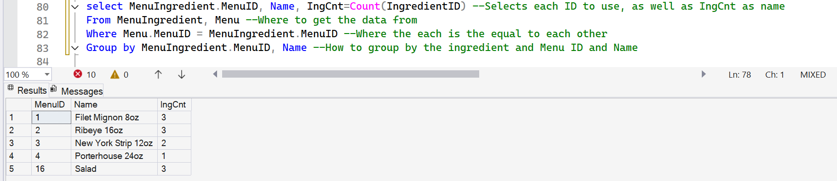
18) Which Menu Item had the most Ingredients.

Slide 19
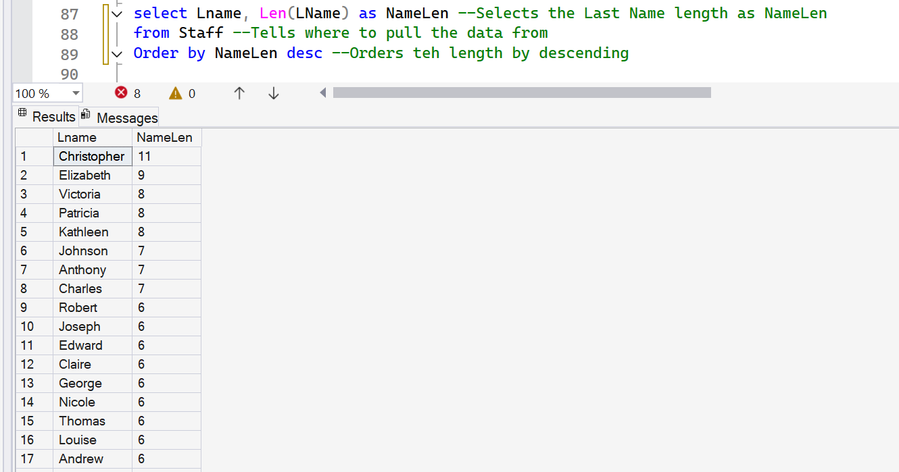
19) Which Staff member had the longest Last Name.

Slide 20
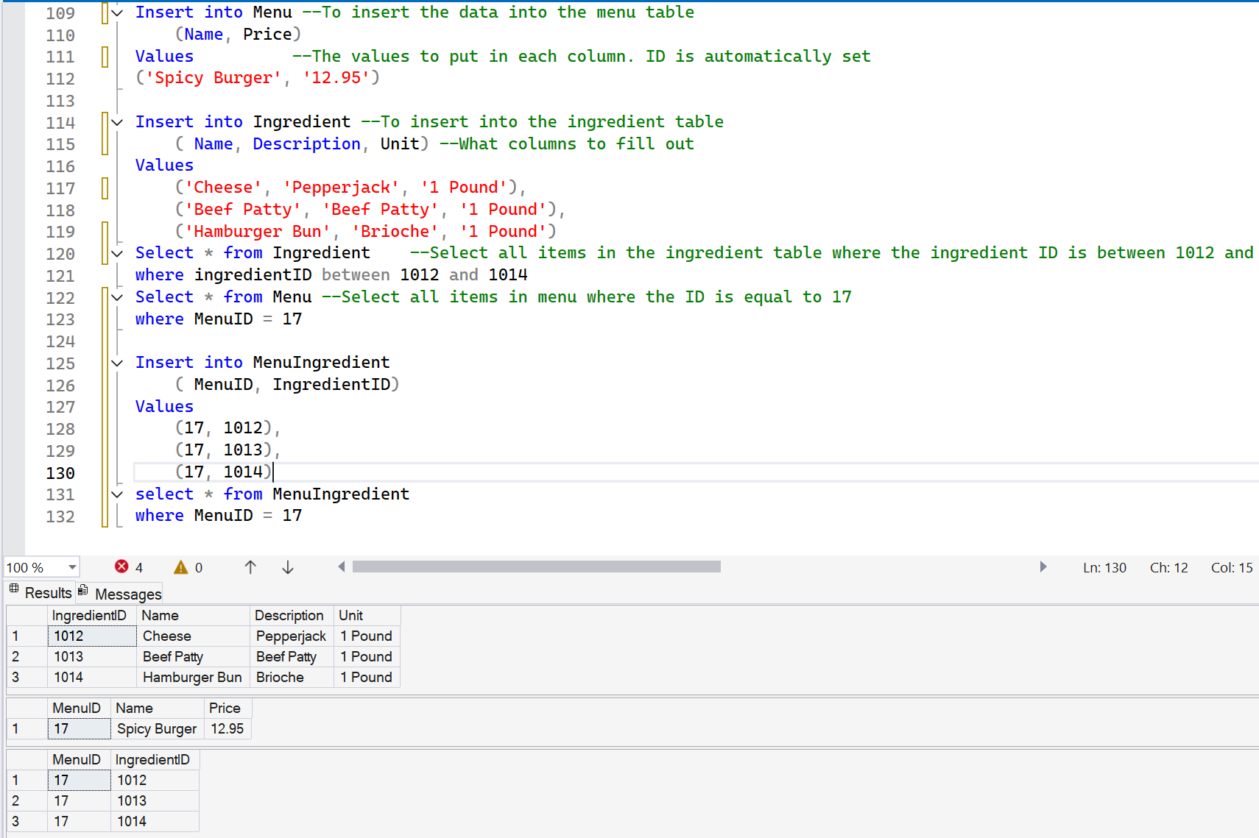
20) Write a script that creates the data to have a Menu item with more than one Ingredient as well as a script to display that Menu item and it's Ingredients.

